Slide 1

AI Prediction of Venetoclax Response and Safety in Acute Myeloid Leukemia (AML) Patients
Dr. Pratibha Choudhary
Northwestern University School of Professional Studies
Master of Science in Data Science
405 Church St, Evanston, IL 60201
Notes:
"Hello everyone, my name is Pratibha Choudhary, and today I will present my capstone project on using artificial intelligence to predict treatment response in Acute Myeloid Leukemia, or AML.
Specifically, this project focuses on Venetoclax, a targeted therapy used for AML patients.
The goal of this work is to determine whether patient molecular data — what we call multi-omics data — can help us predict who will respond to treatment and who may be at higher clinical risk before therapy begins.“
Transition
"To understand why this problem matters, let me start with a clinical scenario."

Slide 2
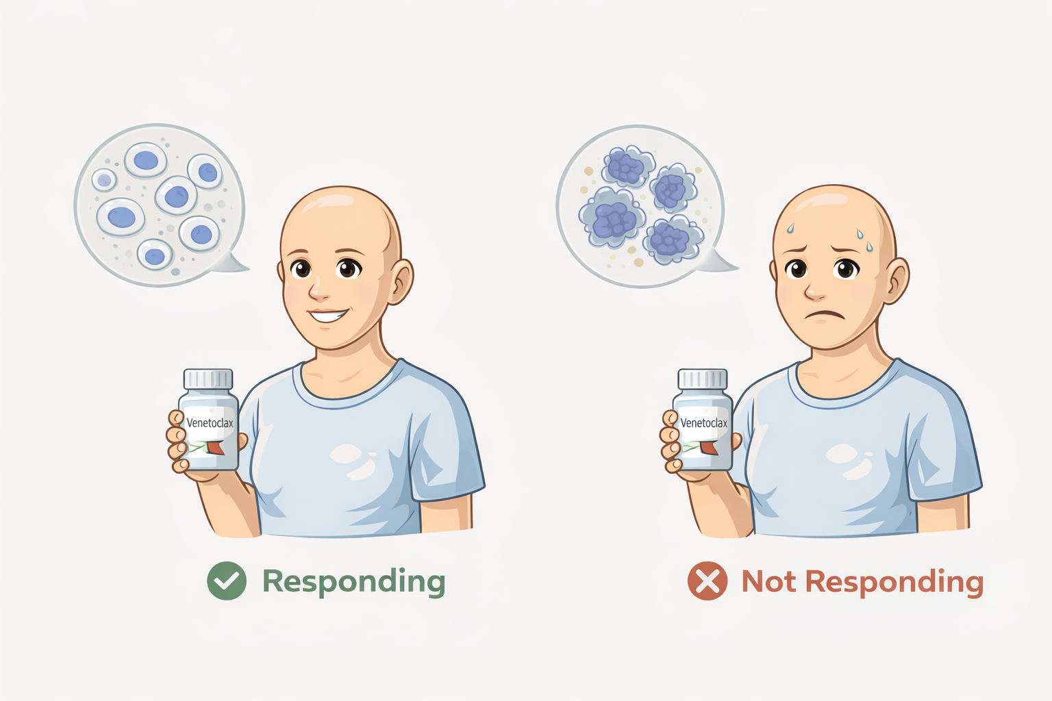
Introduction and Problem Statement : Clinical Motivation
Notes:
Imagine two patients diagnosed with the same type of leukemia.
Both receive the same targeted drug, Venetoclax. One patient responds extremely well and the leukemia cells disappear. But the other patient shows almost no response and the disease progresses.
Clinically, it is very difficult to predict which patient will benefit from this therapy.
In this project, I developed an AI approach that uses molecular data to predict treatment response and identify higher-risk patients before therapy begins

Slide 3
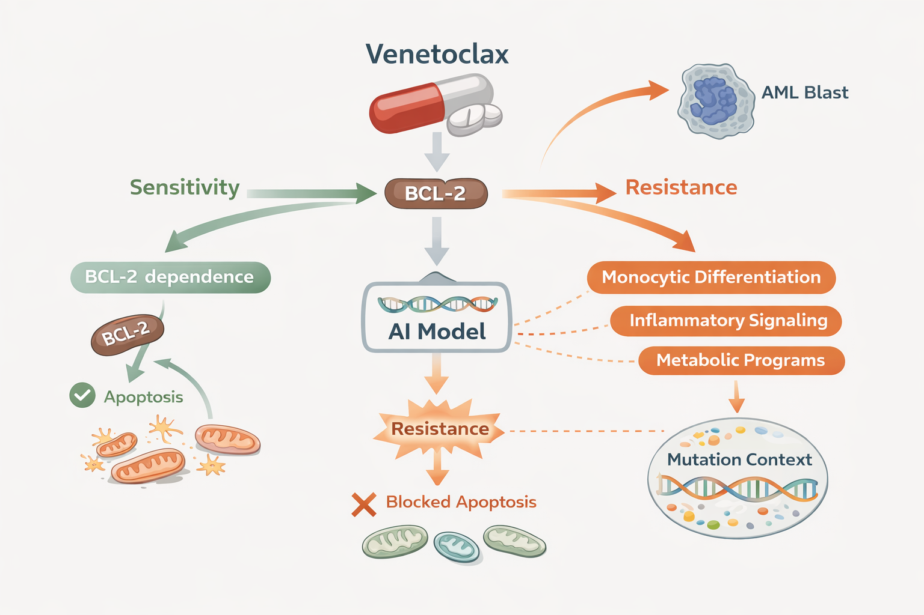
Goal: Predict Response and Safety Risk Using Multi‑omics Based AI models
Patient Molecular data
“Multi-omics data”
Notes:
Acute Myeloid Leukemia, or AML, is an aggressive blood cancer.
Venetoclax is a targeted therapy that helps many AML patients, but not everyone responds to it.
In this project, I developed an AI pipeline that uses patient molecular data to predict two things: whether a patient is likely to respond to venetoclax and whether they may belong to a higher-risk disease group.
The goal is to move toward more personalized treatment decisions.

Slide 4
Data: BeatAML2 (Multi-omics Dataset)
Large AML cohort (805 patients)
RNA‑seq gene expression
Mutation calls (WES)
AML malignant cell‑state programs
Clinical annotations and venetoclax drug response (AUC)

Slide 5
Modeling Pipeline
Patient samples
↓
↓
Multi-omics data (BeatAML2)
RNA-seq | Mutations | Cell states
Machine learning models
Logistic regression | Neural network
↓
↓
Feature engineering
Genes200 | WGCNA modules | Pathway Signatures | Random forest generated (RF8) gene panel
Prediction
Response | Safety risk
↓
↓
Feature engineering
Genes200 | WGCNA modules | Pathway Signatures | Random forest generated (RF8) gene panel
Evaluation methods: 5‑fold cross‑validation using AUROC and AUPRC
Notes:
Our modeling pipeline follows three main steps.
First, we extract biological features from molecular data, including gene-expression patterns, mutation information, and cell-state scores.
Next, these features are combined into a unified dataset for each patient sample.
Finally, we train machine learning models to predict treatment response and safety risk using cross-validation to ensure reliable performance estimates.

Slide 6
Baseline Model Performance
Genes200 + CellTypes + Mut50 AUROC ≈ 0.86
WGCNA modules AUROC ≈ 0.83
Signature features AUROC ≈ 0.84
Safety prediction AUROC ≈ 0.80

Slide 7
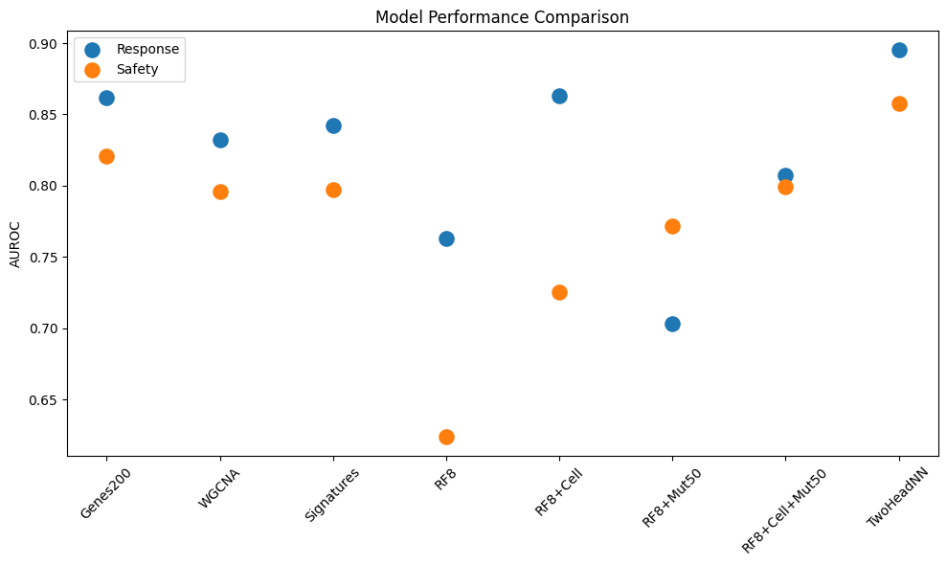
Model Performance Comparison

Slide 8
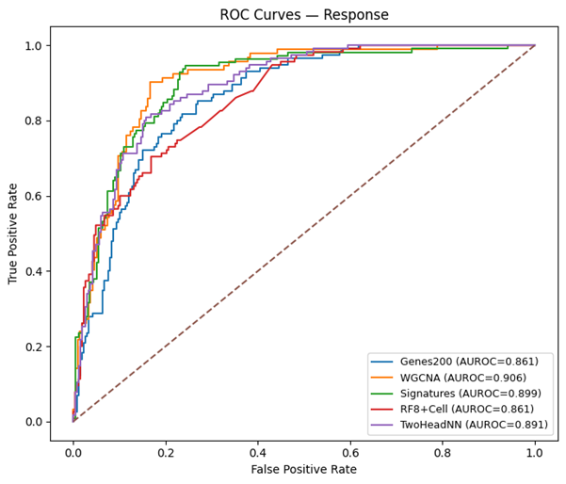
ROC Curves Across Major Models For Venetoclax Response Prediction

Slide 9
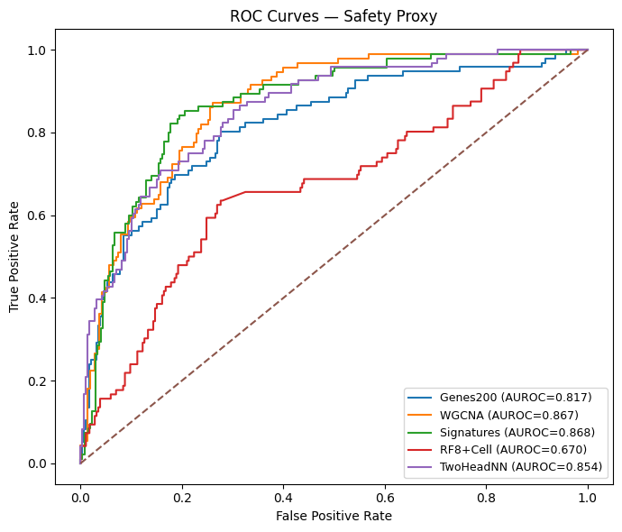
ROC Curves Across Major Models For Venetoclax Safety Prediction

Slide 10
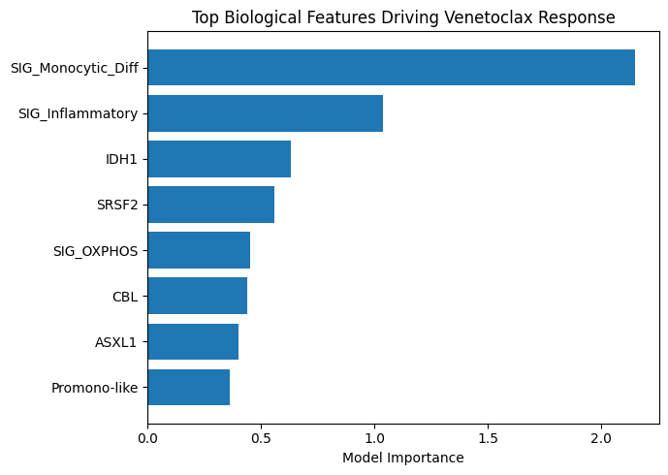

Top Biological Features Driving Venetoclax Response

Slide 11
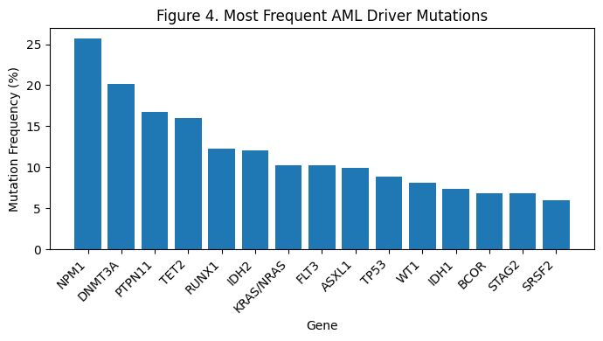
AML Mutation Landscape

Slide 12
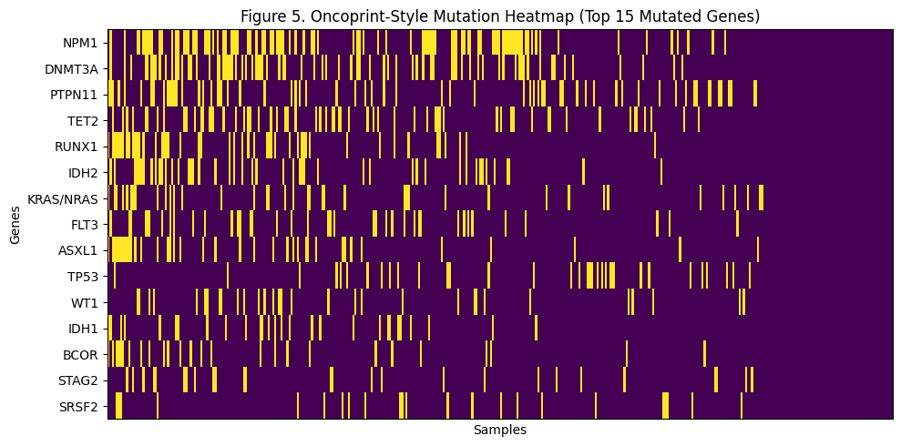
Oncoprint of Top AML Mutations

Slide 13
Key Biological Insight
Monocytic differentiation is strongly associated with reduced venetoclax response
Inflammatory signaling and metabolic programs also contribute
Highlights the importance of AML cell state in therapy resistance

Slide 14
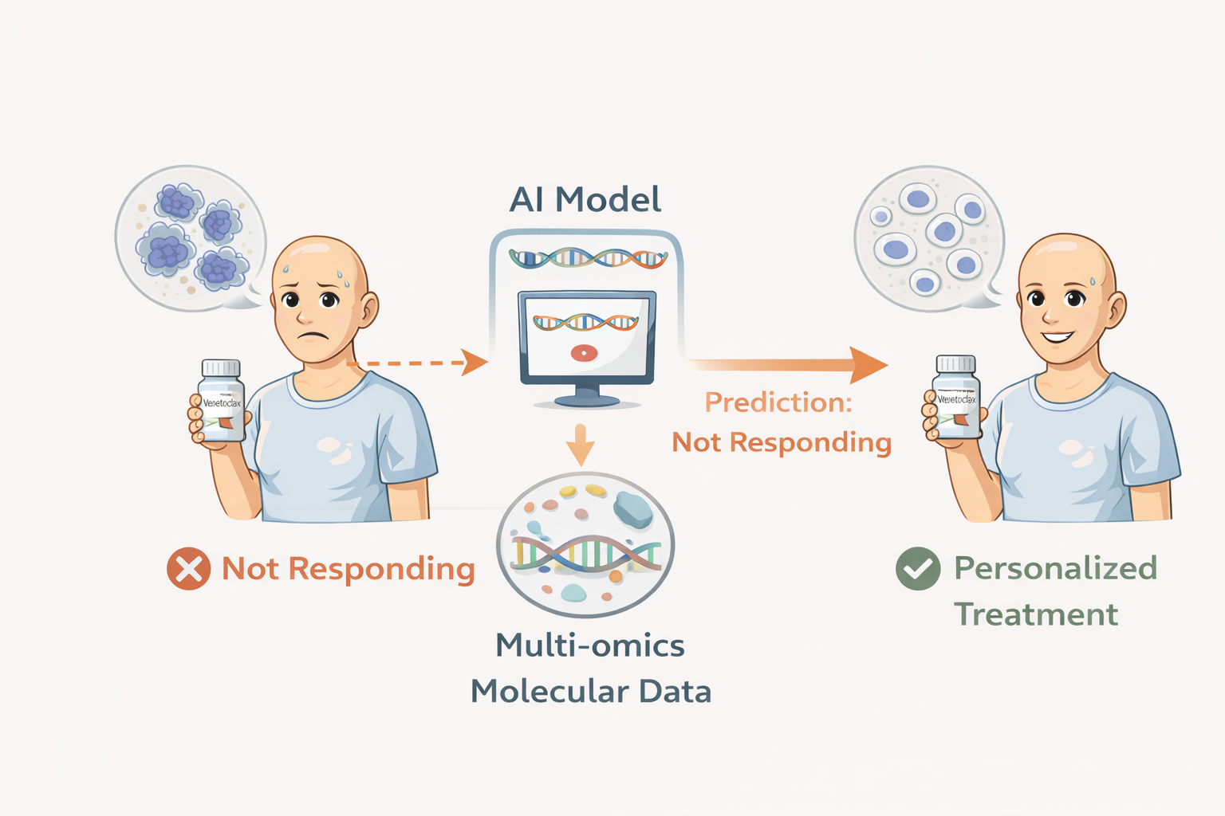
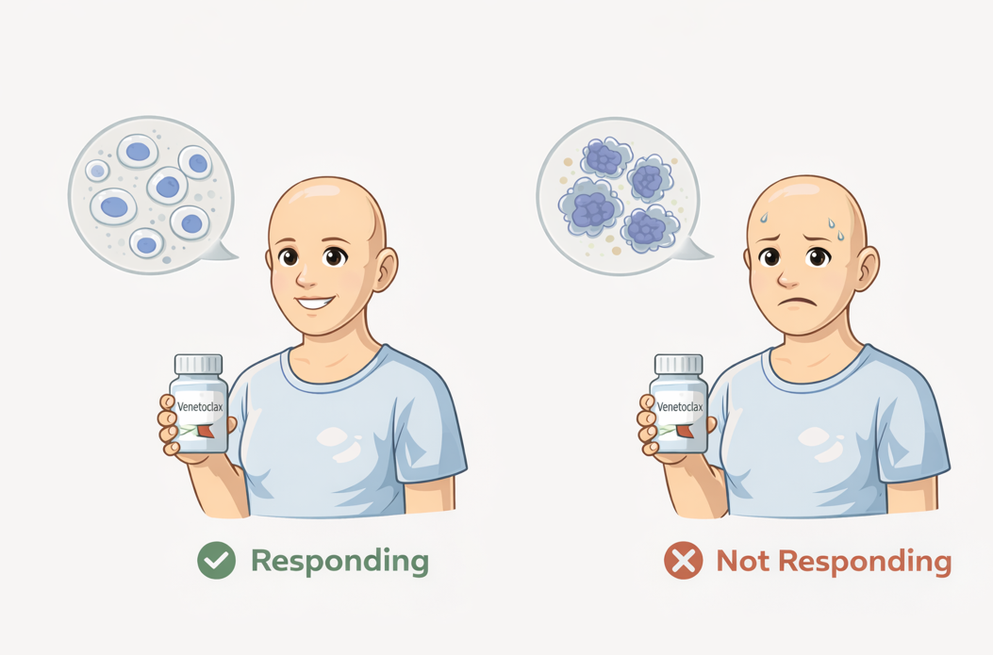

Slide 15
Conclusions
Multi‑omics AI models can predict venetoclax response in AML
Biological program features preserve predictive signal
Multitask neural networks achieve the strongest overall performance
Potential application for biomarker discovery and precision medicine

Slide 16

Acknowledgment
Open sourced BeatAML2 dataset
MSDS Northwestern University
All MSDS faculty
Special thanks to Prof. Alianna J. Maren for her “portfolio-driven approach to this capstone project”.

